Slide 1
WMO Consultation on climate data homogenization
Use case from: NMHS Madagascar
Contact: Luc Yannick Andréas RANDRIAMAROLAZA (PhD)
PR of Madagascar with the WMO
Director General of DGM
randriamarolaza.luc@gmail.com
Date: 26/Sep/2025

Slide 2
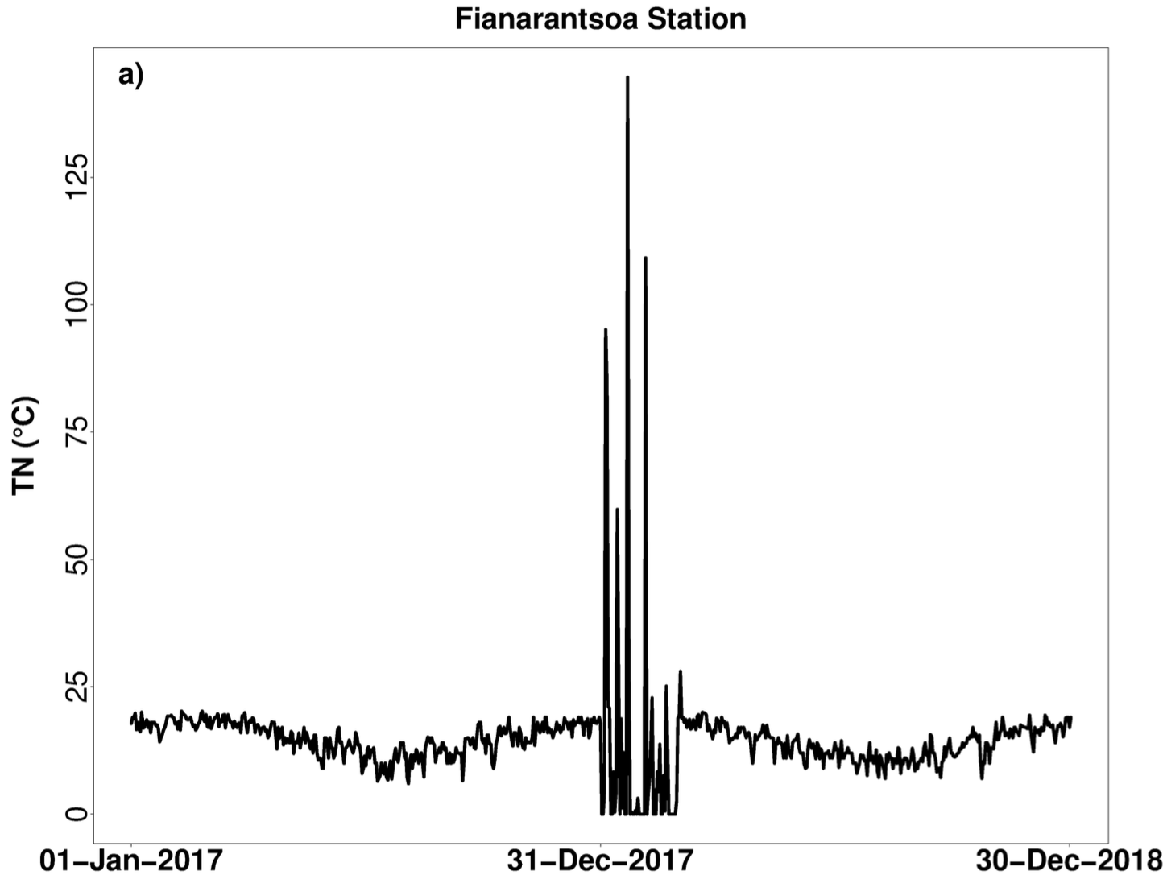
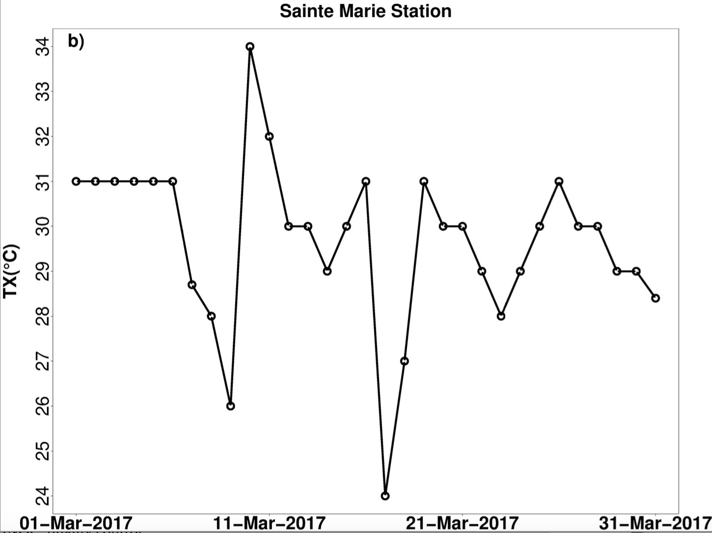
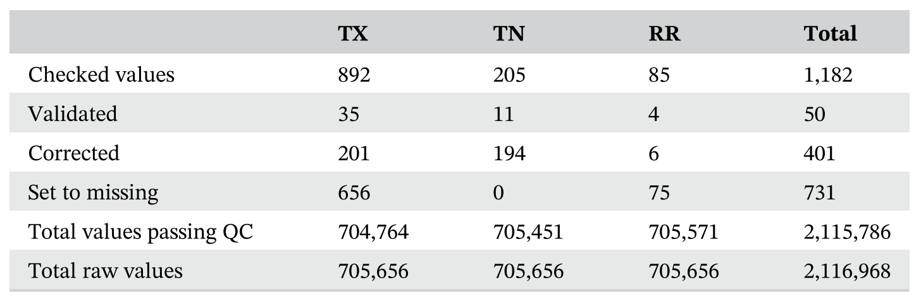
Homogenization: data processes, product, and services
Assess the quality control of observational datasets by using the INQC tool developed by the INDECIS project
﻿Examples of error types in raw data (a) erroneous and (b) suspects and collectively suspects
Errors due to digitalization process
Suspect values due to sensor failure
0.06% values are flags from 1 to 4
More flag values are found in temperature, especially TX, than in precipitation
Missing data percentage
Correction | TX | TN | RR
Before | 15.70% | 16.10% | 10.20%
After | 16.35% (+0.65%) | 15.98% (-0.12%) | 10.19% (-0.01%)

Slide 3
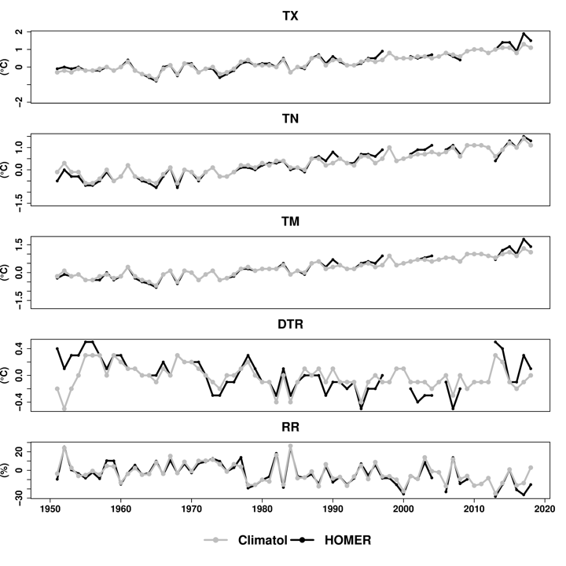
Homogenization: data processes, products, and services
2. Homogenize the quality-controlled observational datasets by applying two different approaches;
Semi-automatic procedure with HOMER software: Breakpoint detection is done on a monthly scales 19 weather synoptic stations Subjective pairwise comparison technique and Joint-segmentation methods manual acceptance or rejection of breakpoints detected by using the metadata Daily adjustment by linear interpolation using monthly and annual factors No gaps fill in
Automatic procedure with CLIMATOL software:
Breakpoint detection is done on a monthly scale
26 weather synoptic stations
A modified version of ﻿the Standard Normal Homogeneity Test (SNHT)
Any acceptance or rejection is done by using the metadata
Daily adjustment by orthogonal regression or Reduced Major Axis
iterative process to fill gaps in mean and standard deviation calculation

Slide 4
Homogenization: projects, needs and issues
Data rescue : Digitalization and Improvement of the archive of the recorded datasets
Capacity building : Training on other methods of homogenization
Equipment and materials : Operationalisation of the methods

Slide 5
References
Randriamarolaza, L.Y.A., Aguilar, E., Skrynyk, O., Vicente- Serrano, S.M. & Domínguez-Castro, F. (2021) Indices for daily temperature and precipitation in Madagascar, based on quality-controlled and homogenized data, 1950–2018. International Journal of Climatology, 42 (1), 265–288. Available from: https://doi.org/10.1002/joc.7243 [JCR Q1, IF 3.651]
Randriamarolaza, L.Y.A., Aguilar, E. & Skrynyk, O. (2023) Extreme temperatures detection and attribution related to external forcing in Madagascar. International Journal of Climatology, 43 (8), 3907-3924. Available from: https://doi.org/10.1002/joc.8065 [JCR Q1, IF 3.651]
Randriamarolaza, L.Y.A. & Aguilar, E. (2023) Rainy season and crop calendars comparison between past (1950-2018) and future (2030-2100) in Madagascar. Meteorological Applications, 30 (5), e2146. Available from https://doi.org/10.1002/met.2146
[JCR Q3, IF 2.451]

